Slide 1
UML (Unified Modeling Language) Diagrams
Software Engineering
Neil Toporski

Slide 2
1 Class Diagrams
UML Types
Class Diagrams
What is a Class?
Notation
Perspectives
Relationships Between Classes
Example

Slide 3
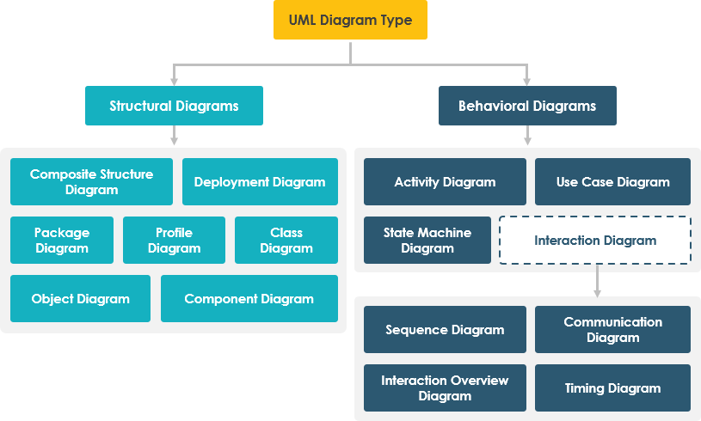

1.1 Unified Modeling Language (UML) Diagram Type

Slide 4
1.2 Class Diagrams
The Class diagram is a graphical notation used to construct and visualize object-oriented systems. A class diagram in the Unified Modeling Language (UML) is a type of static structure diagram that describes the structure of a system by showing the system's:
classes,
their attributes,
operations (or methods),
and the relationships among objects.

Slide 5
1.3 What is a Class?
A Class is a blueprint for an object. The entire point of Object-Oriented Design is not about objects, it's about classes, because we use classes to create objects. So, a class describes what an object will be, but it isn't the object.

Slide 6
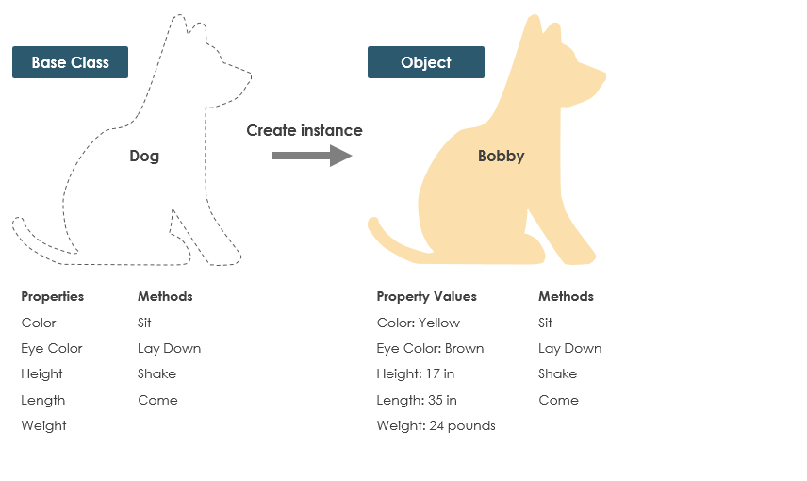
What is a Class?
A dog has states - color, name, breed as well as behaviors -wagging, barking, eating. An object is an instance of a class.

Slide 7
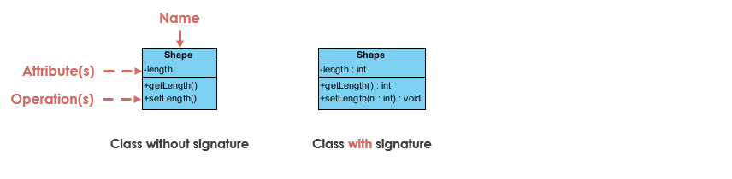
1.4 Class Notation
A class represent a concept which encapsulates state (attributes) and behavior (operations). Each attribute has a type. Each operation has a signature. The class name is the only mandatory information

Slide 8
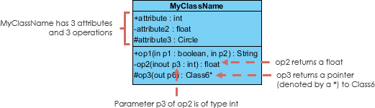
Class Partitions
Class Name
The name of the class appears in the first partition.
Class Attributes
Attributes are shown in the second partition.
The attribute type is shown after the colon.
Attributes map onto member variables (data members) in code.
Class Operations (Methods):
Operations are shown in the third partition. They are services the class provides.
The return type of a method is shown after the colon at the end of the method signature.
The return type of method parameters are shown after the colon following the parameter name. Operations map onto class methods in code.

Slide 9
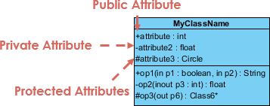
Class Visibility
The +, - and # symbols before an attribute and operation name in a class denote the visibility of the attribute and operation.
+ denotes public attributes or operations
- denotes private attributes or operations
# denotes protected attributes or operations

Slide 10
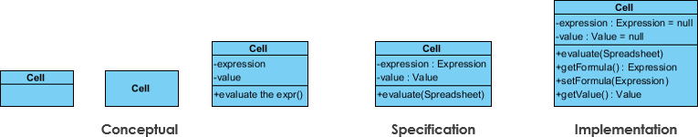
1.5 Perspectives of Class Diagram
A diagram can be interpreted from various perspectives:
Conceptual: represents the concepts in the domain
Specification: focus is on the interfaces of Abstract Data Type (ADTs) in the software
Implementation: describes how classes will implement their interfaces

Slide 11
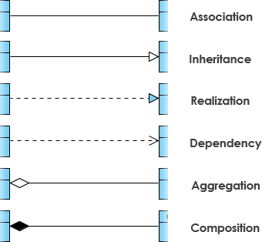
1.6 Relationships Between Classes

Slide 12
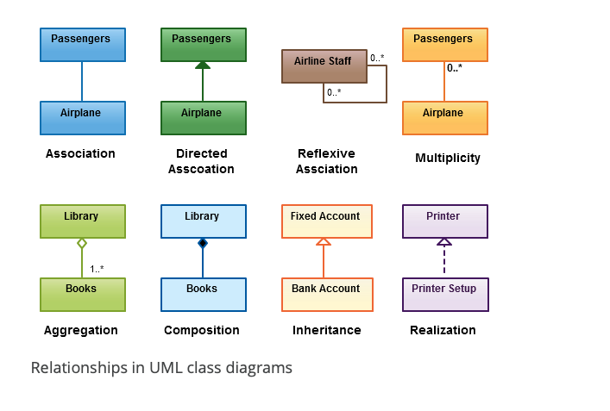
Relationships Between Classes

Slide 13
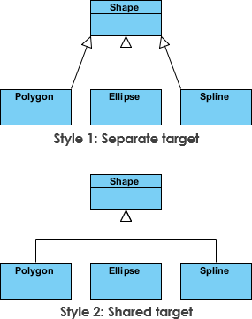
Inheritance (Or Generalization)
A generalization is a taxonomic relationship between a more general classifier and a more specific classifier. Each instance of the specific classifier is also an indirect instance of the general classifier. Thus, the specific classifier inherits the features of the more general classifier.

Slide 14


Association
A structural link between two peer classes.
There is an association between Class1 and Class2
The figure below shows an example of simple association. There is an association that connects the <<control>> class Class1 and <<boundary>> class Class2. The relationship is displayed as a solid line connecting the two classes.

Slide 15


Aggregation
A special type of association.
It represents a "part of" relationship.
Class2 is part of Class1.
Many instances (denoted by the *) of Class2 can be associated with Class1.
Objects of Class1 and Class2 have separate lifetimes.
For example, the class “library” is made up of one or more books, among other materials. In aggregation, the contained classes are not strongly dependent on the lifecycle of the container. In the same example, books will remain so even when the library is dissolved.the aggregate.

Slide 16

Composition
A special type of aggregation where parts are destroyed when the whole is destroyed.
Objects of Class2 live and die with Class1.
Class2 cannot stand by itself.
For example, a shoulder bag’s side pocket will also cease to exist once the shoulder bag is destroyed.
The figure below shows an example of composition. The relationship is displayed as a solid line with a filled diamond at the association end, which is connected to the class that represents the whole or composite.
Notes:
Library destroyed = all the books in it destroyed

Slide 17

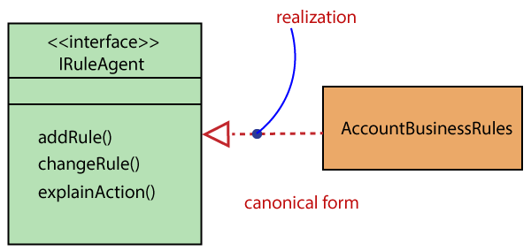
Realization
Denotes the implementation of the functionality defined in one class by another class. To show the relationship in UML, a broken line with an unfilled solid arrowhead is drawn from the class that defines the functionality of the class that implements the function.
One model element (the client) realizes the behavior that the other
For example, the printing preferences that are set using the printer setup interface are being implemented by the printer.
Notes:
For example, rules that define how another class is going to operate

Slide 18
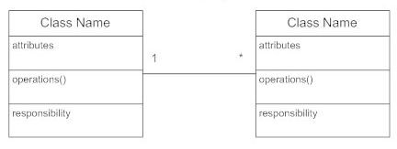
Cardinality
Indicates the number of instances of one class linked to one instance of the other class. For example, one company will have one or more employees, but each employee works for just one company.
(1 to many)
Notes:
The number on one side of the range (used more in database structures)

Slide 19
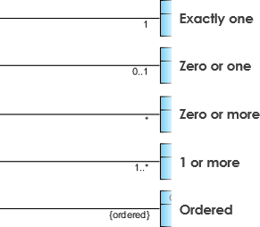
Cardinality
Cardinality is expressed in terms of:
one to one
one to many
many to many
Multiplicity is the range of allowable cardinalities
Multiplicity
Cardinality

Slide 20
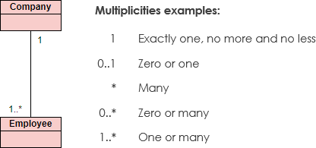
Multiplicity
Notes:
The range (relationship)

Slide 21
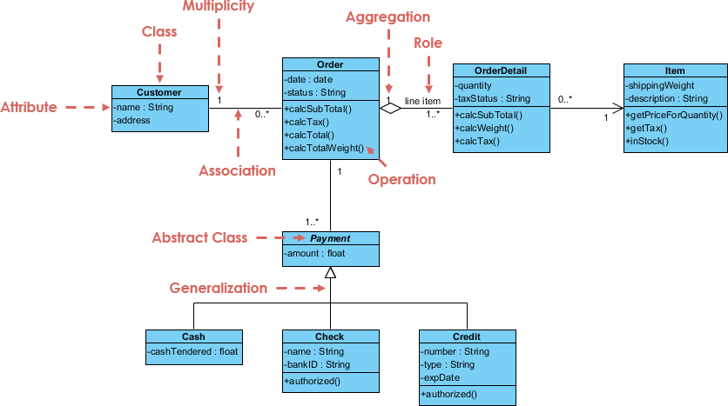
Relationships Between Classes
Notes:
Customer wants to order something
Has order details
Item stuff that defines it
Payment inheritance – cash, check, credit methods
Can order 0 to many different orders
Aggregation – order detail supports what the order is going to look like, 1 to many order details
OrderDetail and Item – association (0 to many order details, and then 1 item?)
Go thru example sometime ig

Slide 22
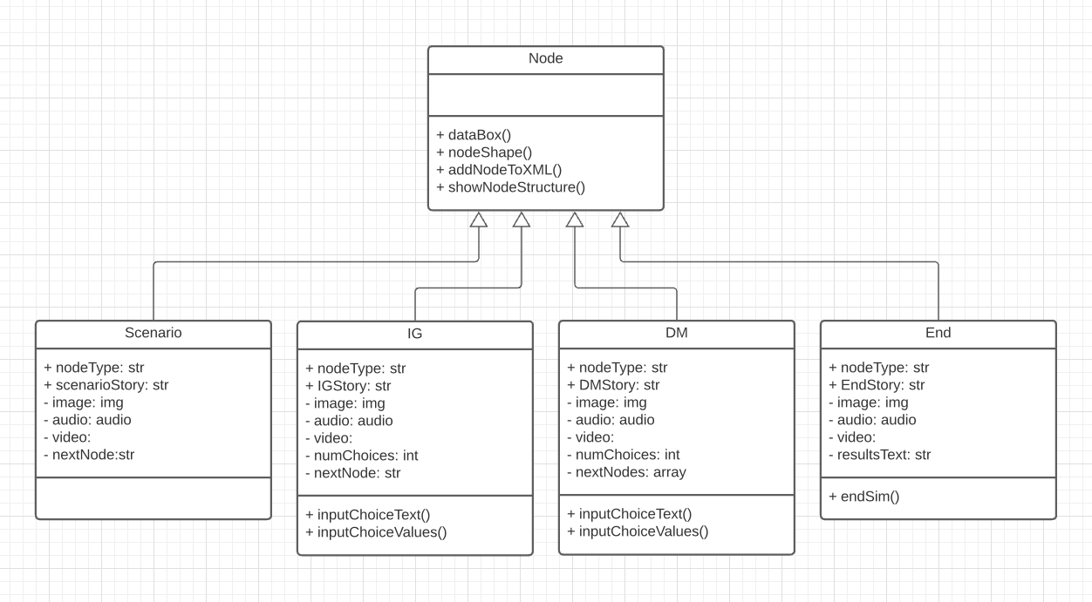
Case-Based Simulation: Node

